Slide 1
Mapas K – 4 Variables
 | 0 | 4 | 12 | 8
 | 1 | 5 | 13 | 9
 | 3 | 7 | 15 | 11
 | 2 | 6 | 14 | 10
W
WX
 | 00 | 01 | 11 | 10
00
01
11
10
YZ
Z
Y
X

Slide 2
 | 0 | 4 | 12 | 8
 | 1 | 5 | 13 | 9
 | 3 | 7 | 15 | 11
 | 2 | 6 | 14 | 10
W
WX
 | 00 | 01 | 11 | 10
00
01
11
10
YZ
Z
Y
X

Slide 3
Display a
 | 0 | 4 | 12 | 8
 | 1 | 5 | 13 | 9
 | 3 | 7 | 15 | 11
 | 2 | 6 | 14 | 10
W
WX
 | 00 | 01 | 11 | 10
00 | 1 | 0 | x | 1
01 | 0 | 1 | x | 1
11 | 1 | 1 | x | x
10 | 1 | 1 | x | x
Implicantes Primos
X’Z’
Y
XZ
W
Implicantes Primos Esenciales
X’Z’
Y
XZ
W
Función Minimizada
a(W, X, Y, Z) = X’Z’+Y+XZ+W
YZ
Z
Y
X

Slide 4
Display b
 | 0 | 4 | 12 | 8
 | 1 | 5 | 13 | 9
 | 3 | 7 | 15 | 11
 | 2 | 6 | 14 | 10
W
WX
 | 00 | 01 | 11 | 10
00 | 1 | 1 | x | 1
01 | 1 | 0 | x | 1
11 | 1 | 1 | x | x
10 | 1 | 0 | x | x
YZ
Implicantes Primos
X’Z’
X’
Y’Z’
YZ
W
Implicantes Primos Esenciales
X’
Y’Z’
YZ
Función Minimizada
b(W, X, Y, Z) = X’+Y’Z’+ YZ
Z
Y
X

Slide 5
Display c
 | 0 | 4 | 12 | 8
 | 1 | 5 | 13 | 9
 | 3 | 7 | 15 | 11
 | 2 | 6 | 14 | 10
W
WX
 | 00 | 01 | 11 | 10
00 | 1 | 1 | x | 1
01 | 1 | 1 | x | 1
11 | 1 | 1 | x | x
10 | 0 | 1 | x | x
YZ
Implicantes Primos
Y’
Z
X
W
Implicantes Primos Esenciales
Y’
Z
X
Función Minimizada
c(W, X, Y, Z) = Y’+Z+X
Z
Y
X

Slide 6
Display d
 | 0 | 4 | 12 | 8
 | 1 | 5 | 13 | 9
 | 3 | 7 | 15 | 11
 | 2 | 6 | 14 | 10
W
Implicantes Primos
X’Z’
X’Y
YZ’
XY’Z
W
Implicantes Primos Esenciales
X’Z’
X’Y
YZ’
XY’Z
W
Función Minimizada
d(W, X, Y, Z) = X’Z’ + X’Y + YZ’ + XY’Z + W
WX
 | 00 | 01 | 11 | 10
00 | 1 | 0 | x | 1
01 | 0 | 1 | x | 1
11 | 1 | 0 | x | x
10 | 1 | 1 | x | x
YZ
Z
Y
X

Slide 7
Display e
 | 0 | 4 | 12 | 8
 | 1 | 5 | 13 | 9
 | 3 | 7 | 15 | 11
 | 2 | 6 | 14 | 10
W
WX
 | 00 | 01 | 11 | 10
00 | 1 | 0 | x | 1
01 | 0 | 0 | x | 0
11 | 0 | 0 | x | x
10 | 1 | 1 | x | x
YZ
Implicantes Primos
X’Z’
YZ’
Implicantes Primos Esenciales
X’Z’
YZ’
Función Minimizada
e(W, X, Y, Z) = X’Z’ + YZ’
Z
Y
X

Slide 8
Display f
 | 0 | 4 | 12 | 8
 | 1 | 5 | 13 | 9
 | 3 | 7 | 15 | 11
 | 2 | 6 | 14 | 10
W
WX
 | 00 | 01 | 11 | 10
00 | 1 | 1 | x | 1
01 | 0 | 1 | x | 1
11 | 0 | 0 | x | x
10 | 0 | 1 | x | x
Implicantes Primos
XZ’
Y’Z’
XY’
W
Implicantes Primos Esenciales
XZ’
Y’Z’
XY’
W
Función Minimizada
f(W, X, Y, Z) = XZ’ + Y’Z’ + XY’ + W
YZ
Z
Y
X

Slide 9
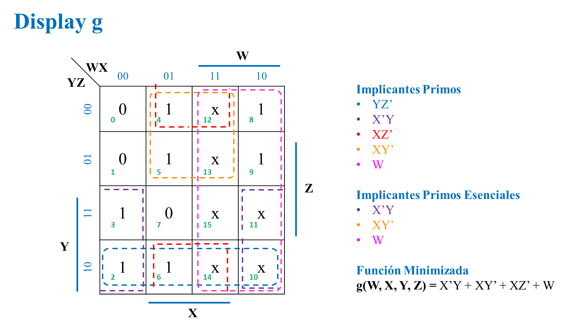

Slide 10
Mapas de K-5 variables, en fusión.
 | 0 | 4 | 12 | 8
 | 1 | 5 | 13 | 9
 | 3 | 7 | 15 | 11
 | 2 | 6 | 14 | 10
 | 16 | 20 | 28 | 24
 | 17 | 21 | 29 | 25
 | 19 | 23 | 31 | 27
 | 18 | 22 | 30 | 26
Implicantes Primos
Implicantes Primos Esenciales
Función Minimizada
J(Q₃Q₂ Q₁Q₀ x) =
Q₃Q₂ Q₁
Q₃
Q₃Q₂ Q₁
Q₃
 | 000 | 001 | 011 | 010
00
01
11
10
 | 110 | 111 | 101 | 100
00
01
11
10
Q₀ x
Q₀ x
X
X
Q₀
Q₀
Q₂
Q₁
Q₁
Q₂

Slide 11
Flip-flop 3: Entrada K₃
 | 0 | 4 | 12 | 8
 | 1 | 5 | 13 | 9
 | 3 | 7 | 15 | 11
 | 2 | 6 | 14 | 10
 | 16 | 20 | 28 | 24
 | 17 | 21 | 29 | 25
 | 19 | 23 | 31 | 27
 | 18 | 22 | 30 | 26
Q₂ Q₁
Q₂
Q₂ Q₁
Q₂
 | 000 | 001 | 011 | 010
00 | x | x | x | x
01 | x | x | x | x
11 | x | x | x | x
10 | x | x | x | x
 | 110 | 111 | 101 | 100
00 | 0 | 1 | x | x
01 | 1 | 1 | x | x
11 | 1 | x | x | x
10 | 1 | x | x | x
Q₀X
Q₀X
X
X
Q₀
Q₀
Q₂
Q₁
Q₁
Q₃

Slide 12
Implicantes Primos
X
Q₀
Q₁
Implicantes Primos Esenciales
X
Q₀
Q₁
Función Minimizada
K₃(Q₃, Q₂, Q₁, Q₀, X) = X + Q₀ + Q₁

Slide 13
Flip-flop 2: Entrada K₂
 | 0 | 4 | 12 | 8
 | 1 | 5 | 13 | 9
 | 3 | 7 | 15 | 11
 | 2 | 6 | 14 | 10
 | 16 | 20 | 28 | 24
 | 17 | 21 | 29 | 25
 | 19 | 23 | 31 | 27
 | 18 | 22 | 30 | 26
Q₂ Q₁
Q₂
Q₂ Q₁
Q₂
 | 000 | 001 | 011 | 010
00 | x | x | 0 | 1
01 | x | x | 1 | 0
11 | x | x | 1 | 0
10 | x | x | 1 | 1
 | 110 | 111 | 101 | 100
00 | x | x | x | x
01 | x | x | x | x
11 | x | x | x | x
10 | x | x | x | x
Q₀X
Q₀X
X
X
Q₀
Q₀
Q₂
Q₁
Q₁
Q₃

Slide 14
Implicantes Primos
Q₁ ’X’
Q₀ X’
Q₁ X
Implicantes Primos Esenciales
Q₁ ’X’
Q₀ X’
Q₁ X
Función Minimizada
K₂(Q₃, Q₂, Q₁, Q₀, X) = Q₁’X’ + Q₀X’ + Q₁X

Slide 15
Flip-flop 1: Entrada K₁
 | 0 | 4 | 12 | 8
 | 1 | 5 | 13 | 9
 | 3 | 7 | 15 | 11
 | 2 | 6 | 14 | 10
 | 16 | 20 | 28 | 24
 | 17 | 21 | 29 | 25
 | 19 | 23 | 31 | 27
 | 18 | 22 | 30 | 26
Q₂ Q₁
Q₂
Q₂ Q₁
Q₂
 | 000 | 001 | 011 | 010
00 | x | 1 | 1 | x
01 | x | 1 | 0 | x
11 | x | 0 | 1 | x
10 | x | 1 | 1 | x
 | 110 | 111 | 101 | 100
00 | x | 1 | x | x
01 | x | 1 | x | x
11 | x | x | x | x
10 | x | x | x | x
Q₀X
Q₀X
X
X
Q₀
Q₀
Q₂
Q₁
Q₁
Q₃

Slide 16
Implicantes Primos
Q₂’Q₀’
X’
Q₂Q₀
Q₃Q₂
Q₃ Q₁
Implicantes Primos Esenciales
X’
Q₂’Q₀’
Q₂Q₀
Función Minimizada
K₁(Q₃, Q₂, Q₁, Q₀, X) = Q₂’Q₀ + X’ + Q₂Q₀

Slide 17
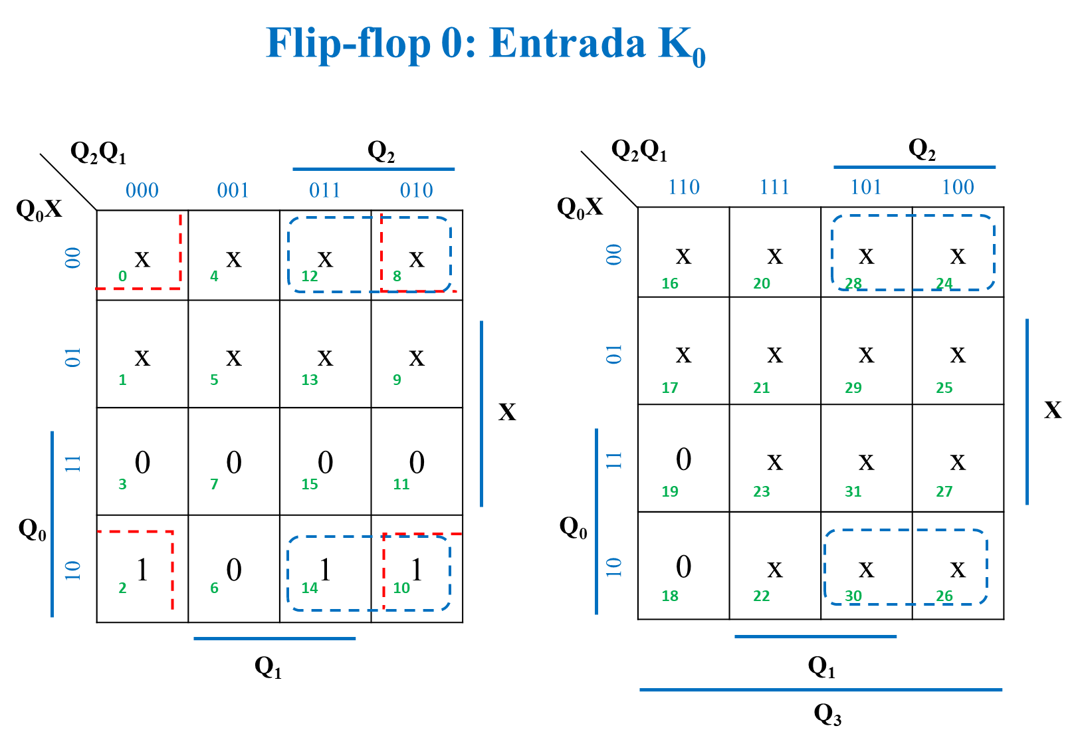
Flip-flop 0: Entrada K₀
 | 0 | 4 | 12 | 8
 | 1 | 5 | 13 | 9
 | 3 | 7 | 15 | 11
 | 2 | 6 | 14 | 10
 | 16 | 20 | 28 | 24
 | 17 | 21 | 29 | 25
 | 19 | 23 | 31 | 27
 | 18 | 22 | 30 | 26
Q₂Q₁
Q₂
Q₂Q₁
Q₂
 | 000 | 001 | 011 | 010
00 | x | x | x | x
01 | x | x | x | x
11 | 0 | 0 | 0 | 0
10 | 1 | 0 | 1 | 1
 | 110 | 111 | 101 | 100
00 | x | x | x | x
01 | x | x | x | x
11 | 0 | x | x | x
10 | 0 | x | x | x
Q₀X
Q₀X
X
X
Q₀
Q₀
Q₁
Q₁
Q₃

Slide 18
Implicantes Primos
Q₃’Q₁’X’
Q₂ X’
Implicantes Primos Esenciales
Q₃’Q₁’X’
Q₂ X’
Función Minimizada
K₀(Q₃Q₂ Q₁Q₀ x) = Q₃’Q₁’X’ + Q₂ X’

Slide 19
Salida S₁
 | 0 | 4 | 12 | 8
 | 1 | 5 | 13 | 9
 | 3 | 7 | 15 | 11
 | 2 | 6 | 14 | 10
 | 16 | 20 | 28 | 24
 | 17 | 21 | 29 | 25
 | 19 | 23 | 31 | 27
 | 18 | 22 | 30 | 26
Q₃Q₂ Q₁
Q₃
Q₃Q₂ Q₁
Q₃
 | 000 | 001 | 011 | 010
00 | 0 | 0 | 1 | 0
01 | 0 | 0 | 1 | 0
11 | 0 | 0 | 0 | 0
10 | 0 | 0 | 0 | 0
 | 101 | 100 | 111 | 100
00 | 0 | 0 | x | x
01 | 0 | 0 | x | x
11 | 1 | x | x | x
10 | 1 | x | x | x
Implicantes Primos
Q₂ Q₁Q₀ ’
Q₃Q₀
Implicantes Primos
Esenciales
Q₂ Q₁Q₀ ’
Q₃Q₀
Función Minimizada
J(Q₃Q₂ Q₁Q₀ x) =
Q₂ Q₁Q₀ ’+Q₃Q₀
Q₀ x
Q₀ x
X
X
Q₀
Q₀
Q₂
Q₁
Q₁
Q₂

Slide 20
Implicantes Primos
Q₂ Q₁Q₀’
Q₃Q₀
Implicantes Primos Esenciales
Q₂ Q₁Q₀’
Q₃Q₀
Función Minimizada
S₁(Q₃, Q₂, Q₁, Q₀, X) = Q₂ Q₁Q₀’ + Q₃Q₀

Slide 21
Mapas de K, en fusión. S₂
 | 0 | 4 | 12 | 8
 | 1 | 5 | 13 | 9
 | 3 | 7 | 15 | 11
 | 2 | 6 | 14 | 10
 | 16 | 20 | 28 | 24
 | 17 | 21 | 29 | 25
 | 19 | 23 | 31 | 27
 | 18 | 22 | 30 | 26
Q₃Q₂ Q₁
Q₃
Q₃Q₂ Q₁
Q₃
 | 000 | 001 | 011 | 010
00 | 0 | 0 | 0 | 0
01 | 0 | 0 | 0 | 0
11 | 0 | 0 | 0 | 0
10 | 0 | 0 | 0 | 0
 | 110 | 111 | 101 | 100
00 | 0 | 0 | x | x
01 | 0 | 0 | x | x
11 | 1 | x | x | x
10 | 1 | x | x | x
Implicantes Primos
Q₃Q₀
Implicantes Primos
Esenciales
Q₃Q₀
Función Minimizada
J(Q₃Q₂ Q₁Q₀ x) =
Q₃Q₀
Q₀ x
Q₀ x
X
X
Q₀
Q₀
Q₂
Q₁
Q₁
Q₂

Slide 22
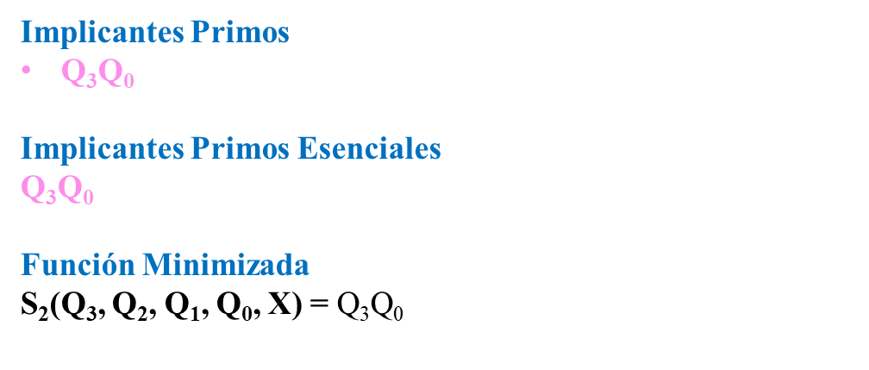
Implicantes Primos
Q₃Q₀
Implicantes Primos Esenciales
Q₃Q₀
Función Minimizada
S₂(Q₃, Q₂, Q₁, Q₀, X) = Q₃Q₀

Slide 23
Mapas de K, en fusión. S₃
 | 0 | 4 | 12 | 8
 | 1 | 5 | 13 | 9
 | 3 | 7 | 15 | 11
 | 2 | 6 | 14 | 10
 | 16 | 20 | 28 | 24
 | 17 | 21 | 29 | 25
 | 19 | 23 | 31 | 27
 | 18 | 22 | 30 | 26
Q₃Q₂ Q₁
Q₃
Q₃Q₂ Q₁
Q₃
 | 000 | 001 | 011 | 010
00 | 0 | 0 | 0 | 0
01 | 0 | 0 | 0 | 0
11 | 0 | 0 | 0 | 0
10 | 0 | 0 | 0 | 0
 | 110 | 111 | 101 | 100
00 | 0 | 1 | x | x
01 | 0 | 1 | x | x
11 | 0 | x | x | x
10 | 0 | x | x | x
Q₀ x
Q₀ x
X
X
Q₀
Q₀
Q₂
Q₁
Q₁
Q₂

Slide 24
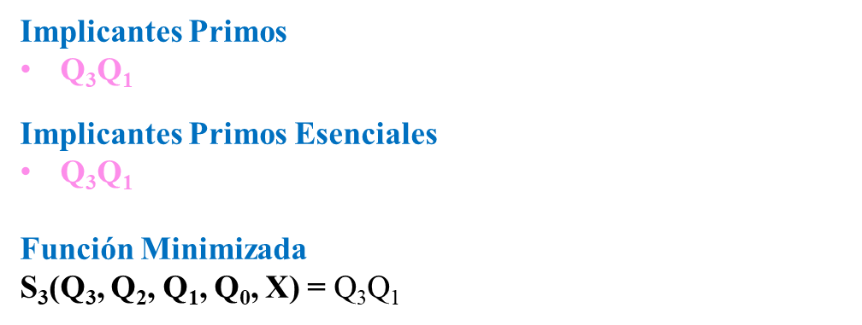
Implicantes Primos
Q₃Q₁
Implicantes Primos Esenciales
Q₃Q₁
Función Minimizada
S₃(Q₃, Q₂, Q₁, Q₀, X) = Q₃Q₁

Slide 25
Flip-flop 3: Entrada J₃
 | 0 | 4 | 12 | 8
 | 1 | 5 | 13 | 9
 | 3 | 7 | 15 | 11
 | 2 | 6 | 14 | 10
 | 16 | 20 | 28 | 24
 | 17 | 21 | 29 | 25
 | 19 | 23 | 31 | 27
 | 18 | 23 | 30 | 26
Q₂
Q₂
Q₂Q₁
 | 00 | 01 | 11 | 10
00 | 0 | 0 | 0 | 0
01 | 0 | 0 | 0 | 0
11 | 0 | 0 | 1 | 0
10 | 0 | 0 | 1 | 0
Q₂Q₁
 | 00 | 01 | 11 | 10
00 | x | x | x | x
01 | x | x | x | x
11 | x | x | x | x
10 | x | x | x | x
Q₀X
Q₀X
X
X
Q₀
Q₀
Q₁
Q₁
Q₃

Slide 26
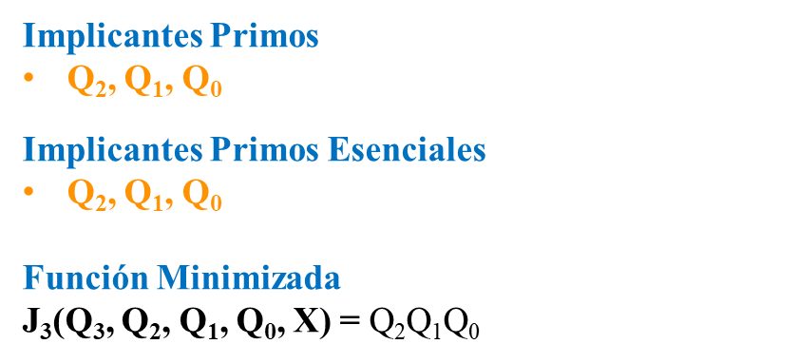
Implicantes Primos
Q₂, Q₁, Q₀
Implicantes Primos Esenciales
Q₂, Q₁, Q₀
Función Minimizada
J₃(Q₃, Q₂, Q₁, Q₀, X) = Q₂Q₁Q₀

Slide 27
Flip-flop 2: Entrada J₂
 | 0 | 4 | 12 | 8
 | 1 | 5 | 13 | 9
 | 3 | 7 | 15 | 11
 | 2 | 6 | 14 | 10
 | 16 | 20 | 28 | 24
 | 17 | 21 | 29 | 25
 | 19 | 23 | 31 | 27
 | 18 | 23 | 30 | 26
Q₂
Q₂
Q₂Q₁
 | 00 | 01 | 11 | 10
00 | 0 | 0 | X | X
01 | 0 | 1 | X | X
11 | 0 | 0 | X | X
10 | 0 | 1 | X | X
Q₂Q₁
 | 00 | 01 | 11 | 10
00 | 0 | 0 | X | X
01 | 1 | 0 | X | X
11 | 0 | X | X | X
10 | 1 | X | X | X
Q₀X
Q₀X
X
X
Q₀
Q₀
Q₁
Q₁
Q₃

Slide 28
Implicantes Primos
Q₃’Q₁Q₀’X
Q₁Q₀’X’
Q₃Q₁’Q₀’X
Q₃Q₀X’
Implicantes Primos Esenciales
Q₃’Q₁Q₀’X
Q₁Q₀’X’
Q₃Q₁’Q₀’X
Q₃Q₀X’
Función Minimizada
J₂(Q₃, Q₂, Q₁, Q₀, X) = Q₃’Q₁Q₀’X + Q₁Q₀’X’ + Q₃Q₀’X + Q₃Q₁’Q₀X’

Slide 29
Flip-flop 1: Entrada J₁
 | 0 | 4 | 12 | 8
 | 1 | 5 | 13 | 9
 | 3 | 7 | 15 | 11
 | 2 | 6 | 14 | 10
 | 16 | 20 | 28 | 24
 | 17 | 21 | 29 | 25
 | 19 | 23 | 31 | 27
 | 18 | 23 | 30 | 26
Q₂
Q₂
Q₂Q₁
 | 00 | 01 | 11 | 10
00 | 0 | X | X | 1
01 | 0 | X | X | 1
11 | 1 | X | X | 1
10 | 1 | X | X | 0
Q₂Q₁
 | 00 | 01 | 11 | 10
00 | 1 | X | X | X
01 | 0 | X | X | X
11 | 1 | X | X | X
10 | 0 | X | X | X
Q₀X
Q₀X
X
X
Q₀
Q₀
Q₁
Q₁
Q₃

Slide 30
Implicantes Primos
Q₀X
Q₃’Q₂’Q₀
Q₂Q₀’
Q₂X
Q₃’Q₀’X’
Implicantes Primos Esenciales
Q₀X
Q₃’Q₂’Q₀
Q₂Q₀’
Q₃’Q₀’X’
Función Minimizada
J₁(Q₃, Q₂, Q₁, Q₀, X) = Q₀X + Q₃’Q₂’Q₀ + Q₂Q₀’ + Q₃’Q₀’X’

Slide 31
Flip-flop 0: Entrada J₀
 | 0 | 4 | 12 | 8
 | 1 | 5 | 13 | 9
 | 3 | 7 | 15 | 11
 | 2 | 6 | 14 | 10
 | 16 | 20 | 28 | 24
 | 17 | 21 | 29 | 25
 | 19 | 23 | 31 | 27
 | 18 | 23 | 30 | 26
Q₂
Q₂
Q₂Q₁
 | 00 | 01 | 11 | 10
00 | 0 | 0 | 1 | 0
01 | 1 | 0 | 1 | 0
11 | X | X | X | X
10 | X | X | X | X
Q₂Q₁
 | 00 | 01 | 11 | 10
00 | 0 | 0 | X | X
01 | 0 | 1 | X | X
11 | X | X | X | X
10 | X | X | X | X
Q₀X
Q₀X
X
X
Q₀
Q₀
Q₁
Q₁
Q₃

Slide 32
Implicantes Primos
Q₃’Q₂’Q₁’X
Q₂Q₁
Q₃Q₁X
Implicantes Primos Esenciales
Q₃’Q₂’Q₁’X
Q₂Q₁
Q₃Q₁X
Función Minimizada
J₀(Q₃, Q₂, Q₁, Q₀, X) = Q₃’Q₂’Q₁’X + Q₂Q₁ + Q₃Q₁X

Slide 33
